Slide 1
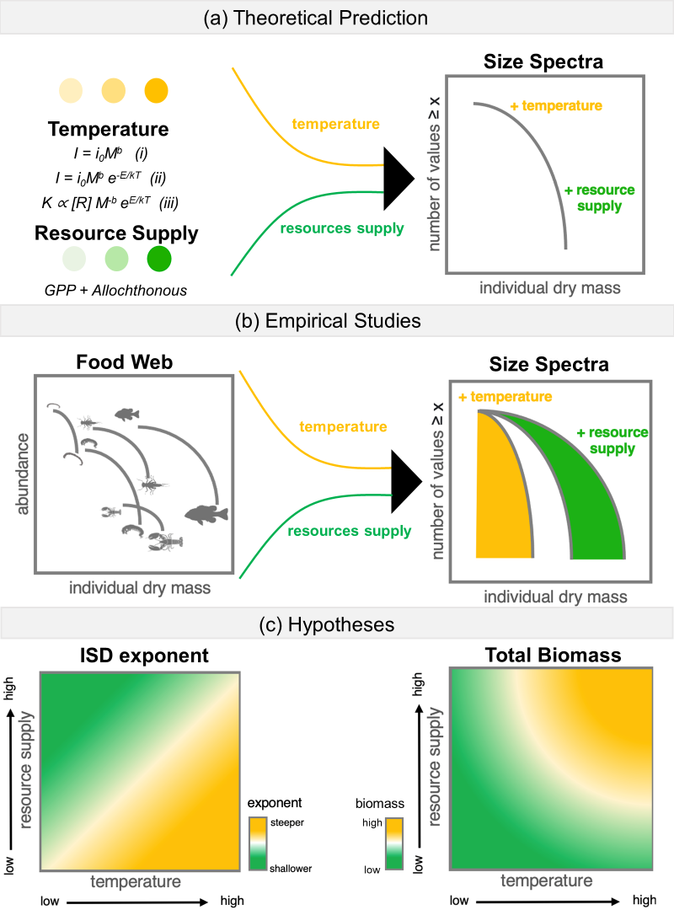

Slide 2

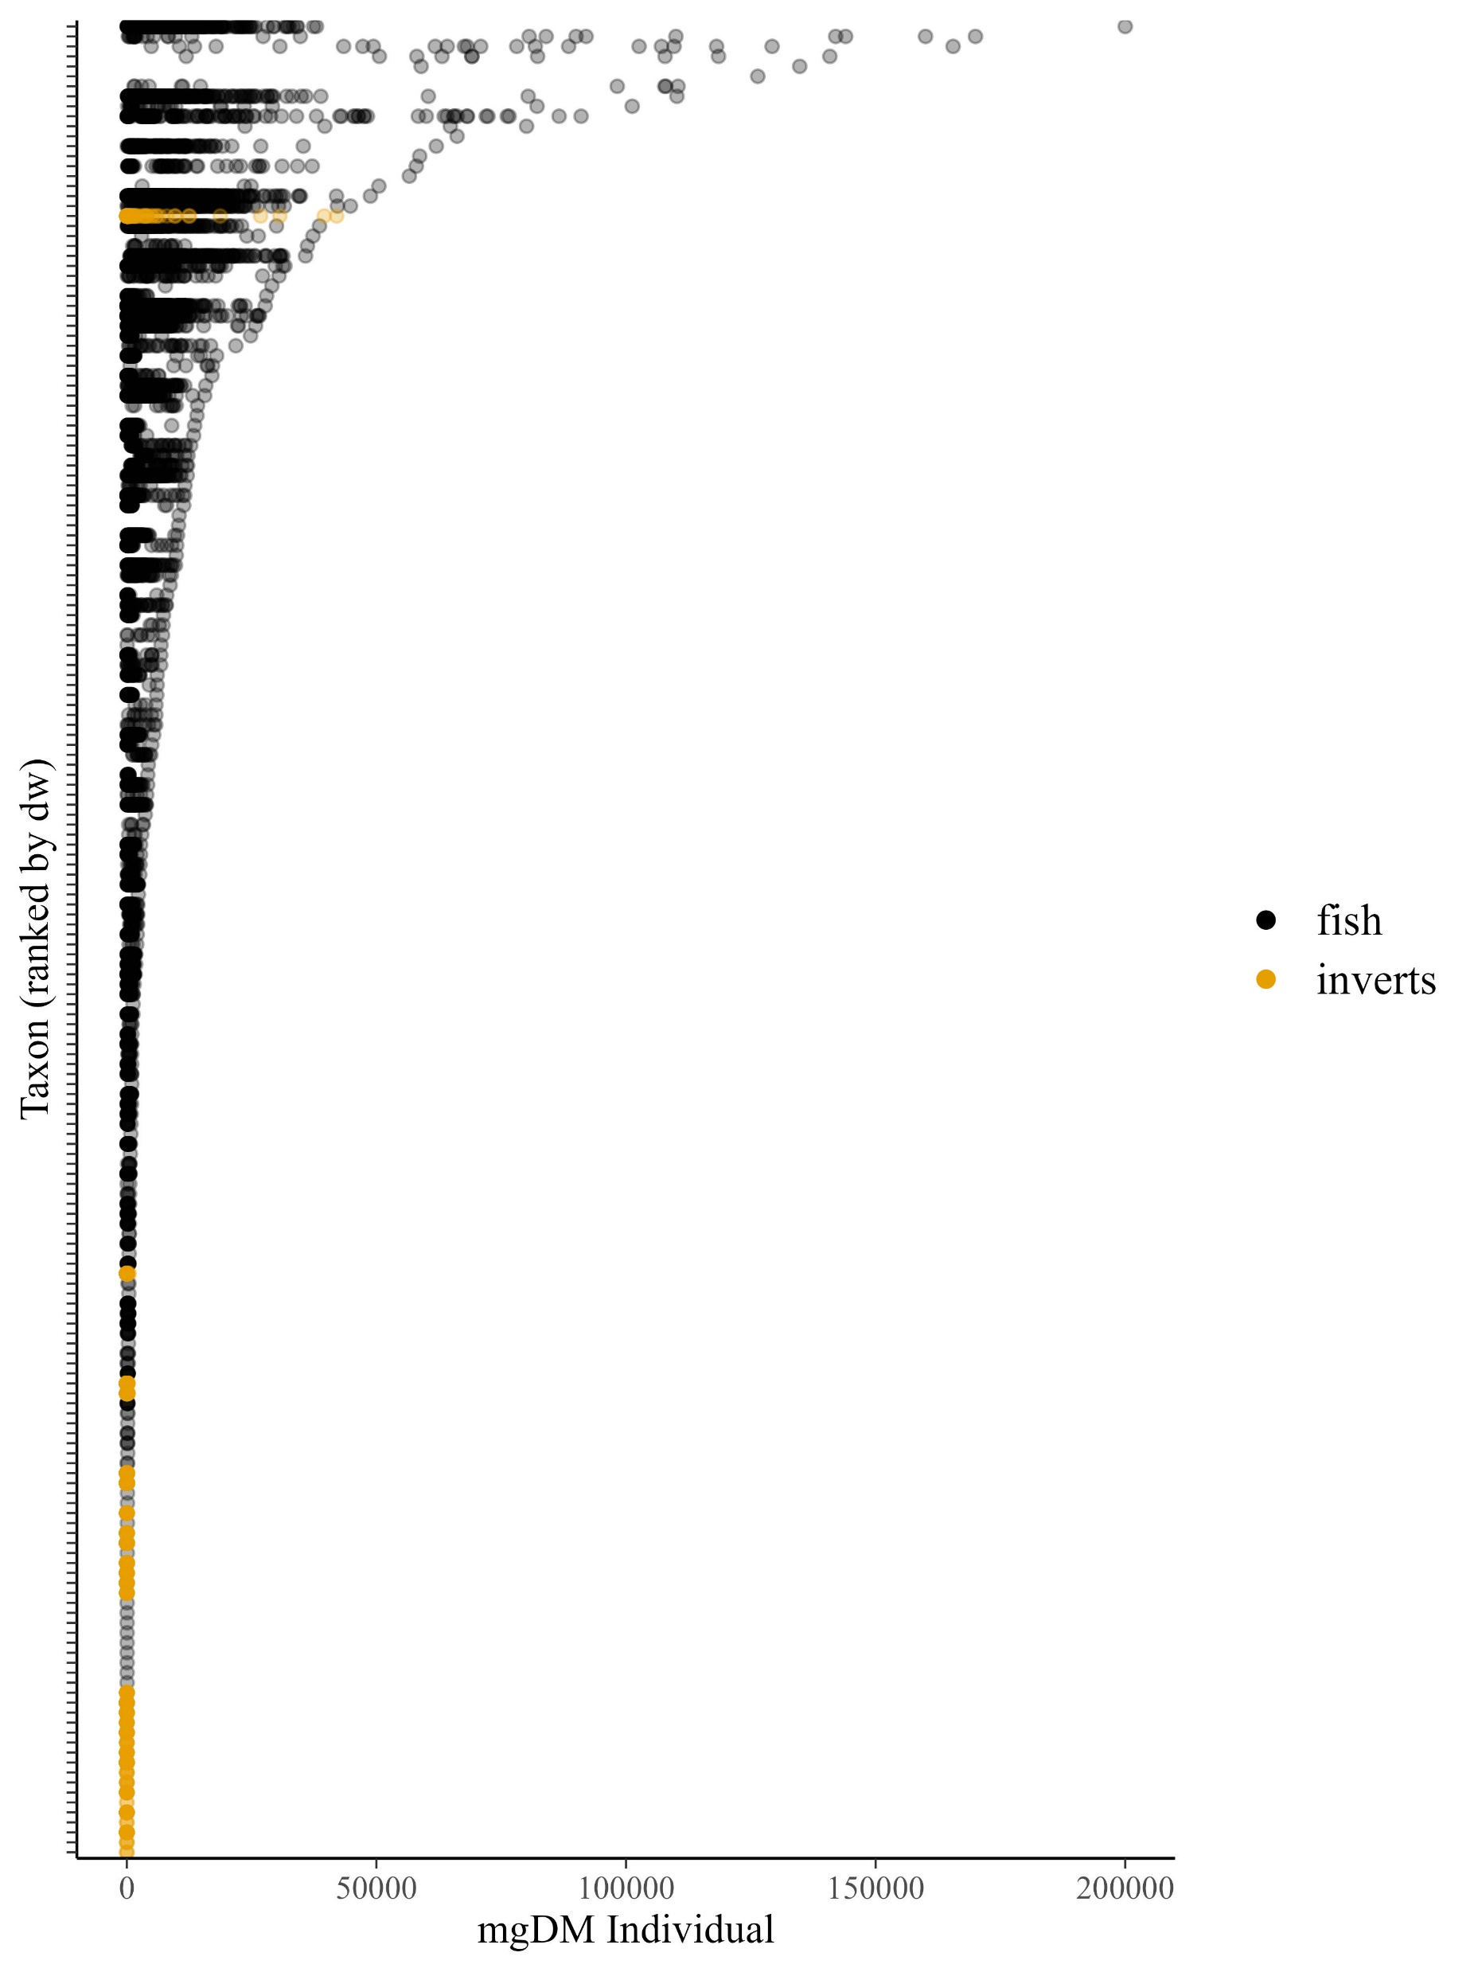







Slide 3
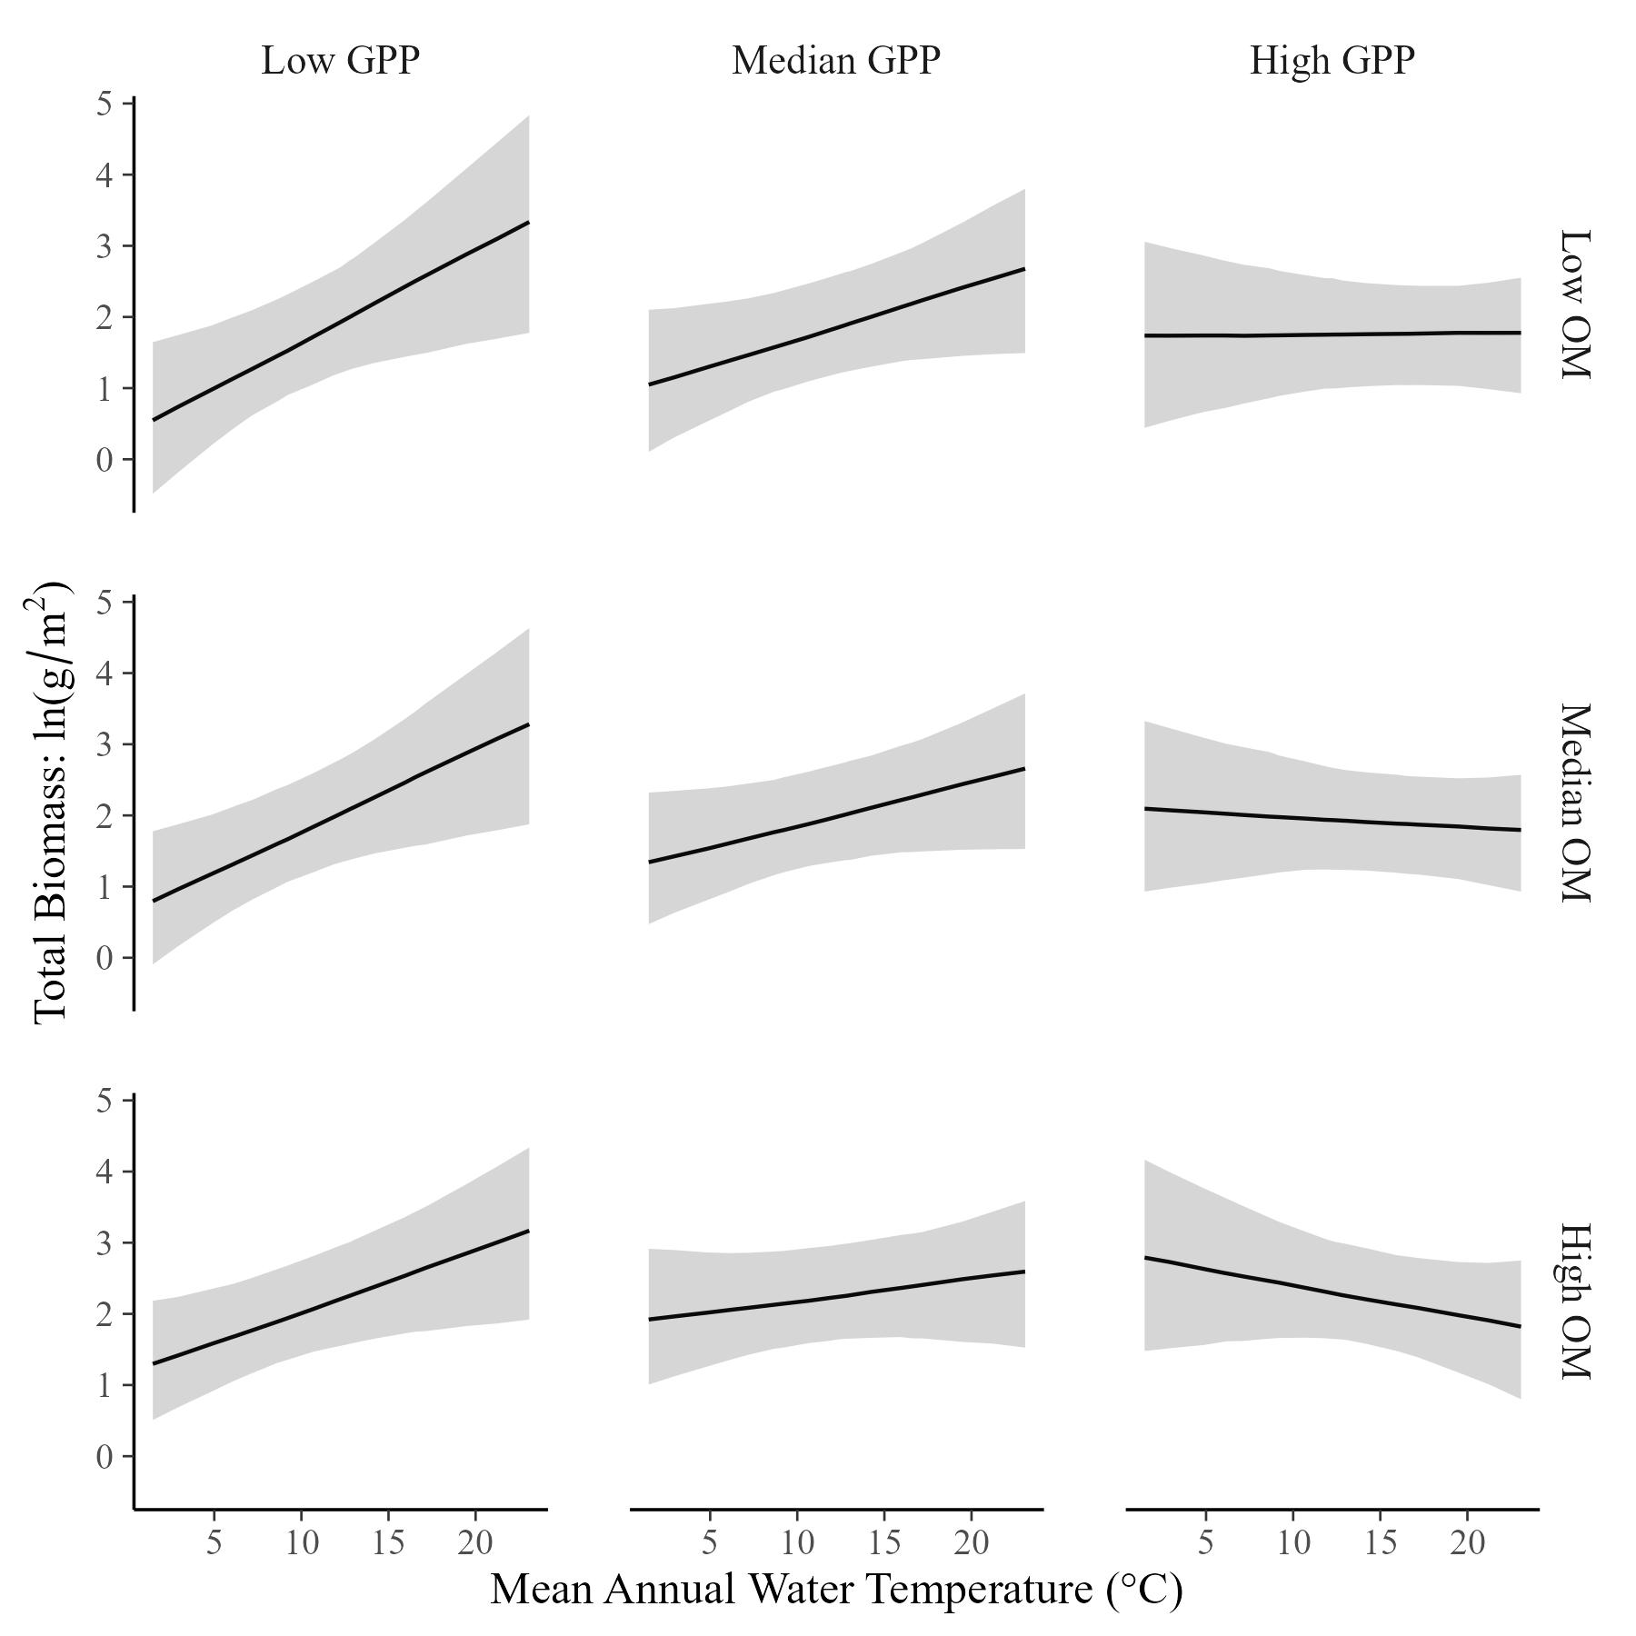
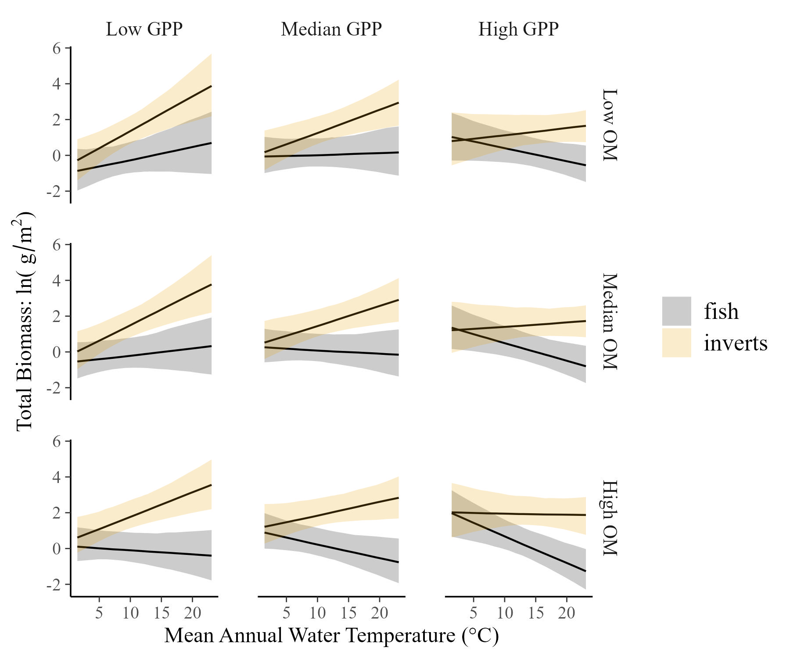
Total Community Biomass varies with temperature and resources…
…and it appears to be a compromise between fish and invertebrates

Slide 4
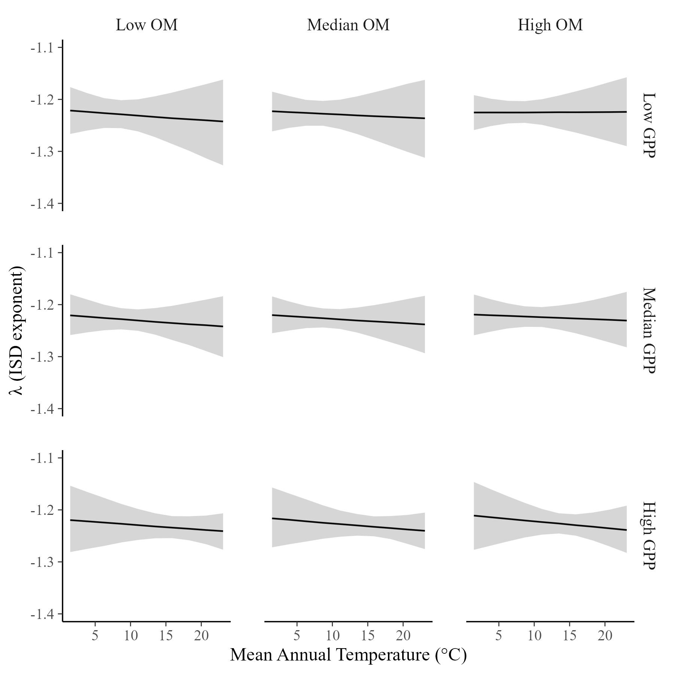
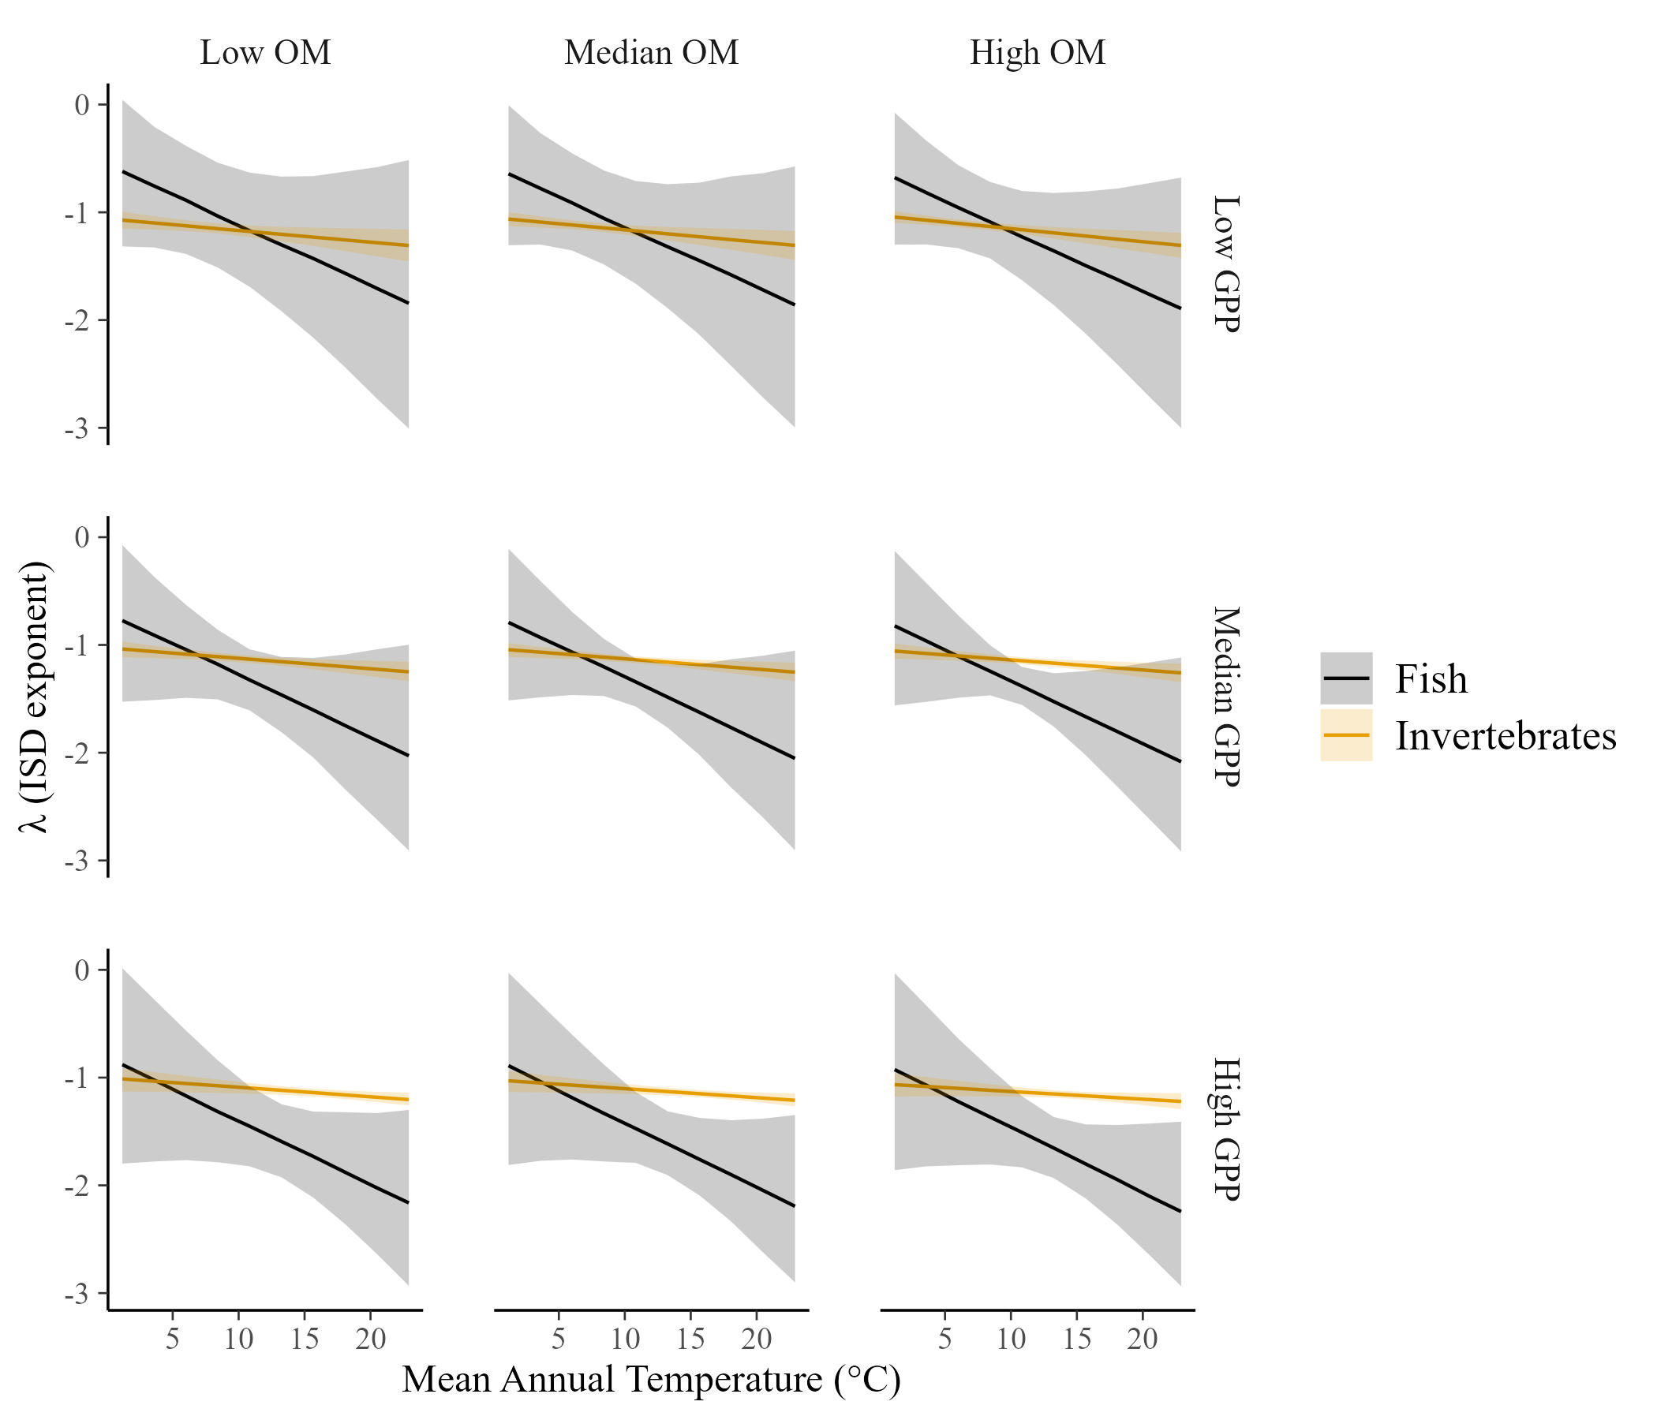
The ISD is constant across temperature and resource supply
…but it varies across temperature for fish and macroinvertebrates

Slide 5
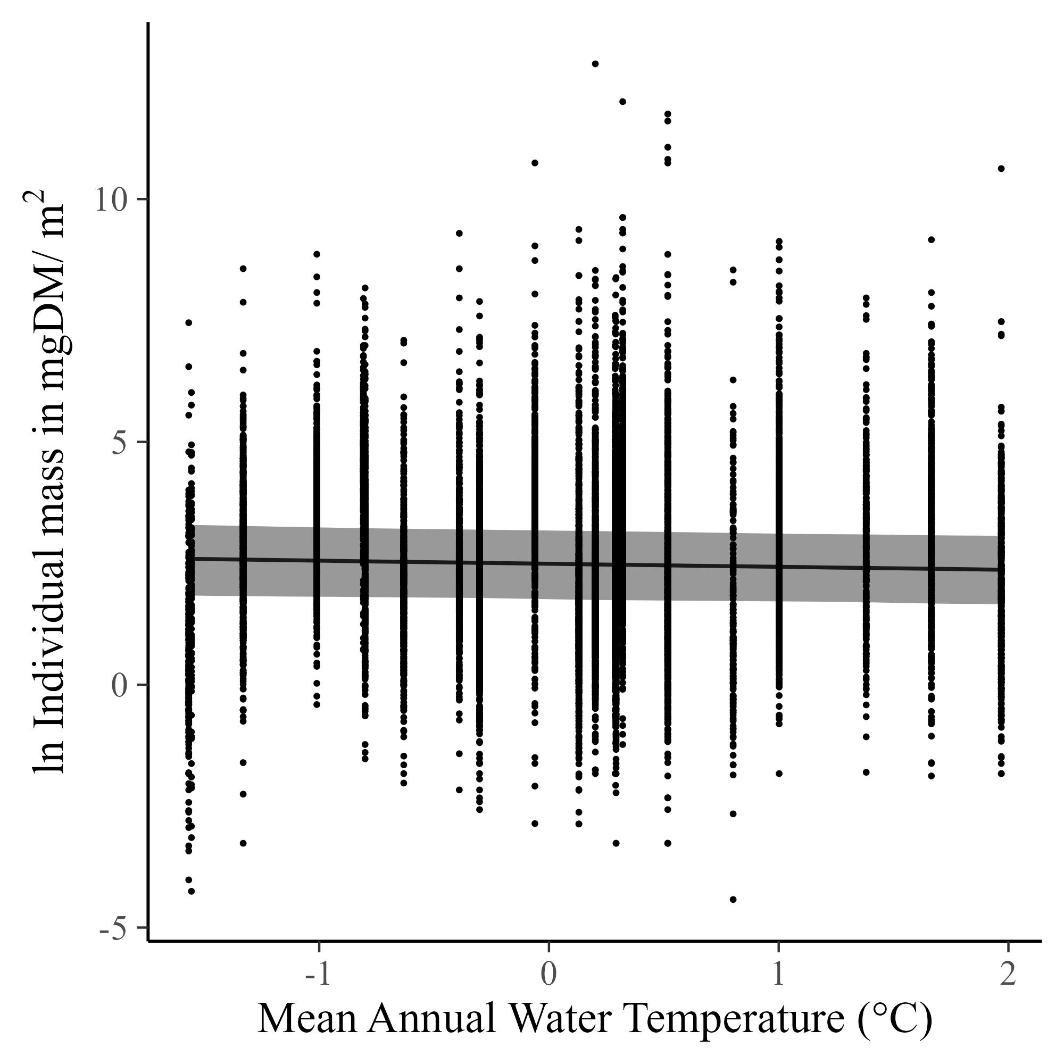
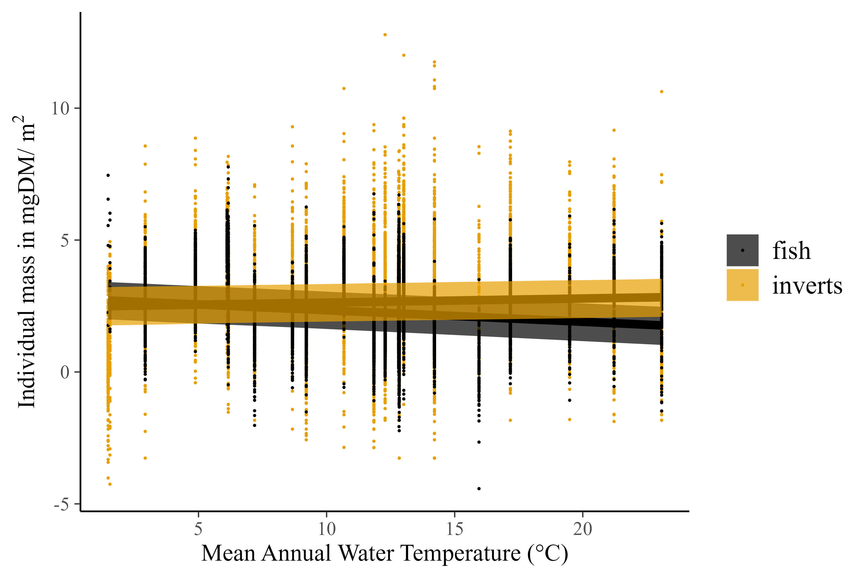
Mean individual sizes decline across temperature….but just barely, from ~13mgDM at the coldest streams to 10mgDM at the warmest (after back-transforming)
Fish and inverts show opposite trends in mean individual mass, with fish declining and inverts staying the same (or increasing).

Slide 6
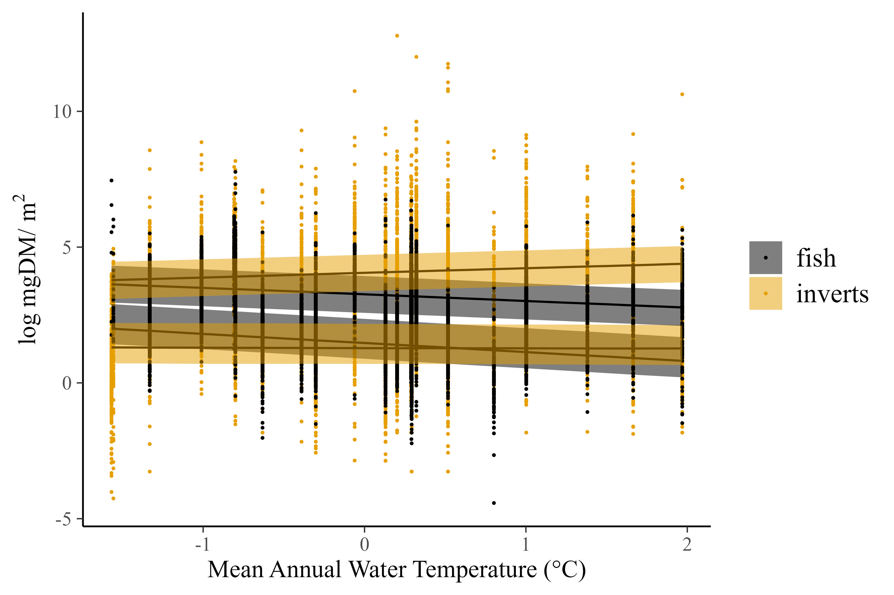
Quantile regression shows that all fish sizes get smaller with increasing temperature. In contrast, small invertebrates (0.2 quantile) don’t change, while large invertebrates (0.8 quantile) get larger. In other words, the increase in large inverts partially makes up for the decrease in fish size, keeping the ISD stable

Slide 7
Stream ISD is invariant to temperature and resource supply
Resource supply (organic matter + GPP)
Large scales of variation in temperature, OM, and GPP (and species composition)
These variables impact total mass and body sizes (also large ranges), but not the shape of the ISD.
Values of ISD are -1.2. That is shallower than predicted, but perhaps explained by the 2d benthic environment (similar to finding of Blanchard). Also perhaps driven by detrital fueled food webs versus more commonly studied pelagic.
Pomeranz et al. 2022 did it wrong. We corrected it by including the whole food web.

Slide 8
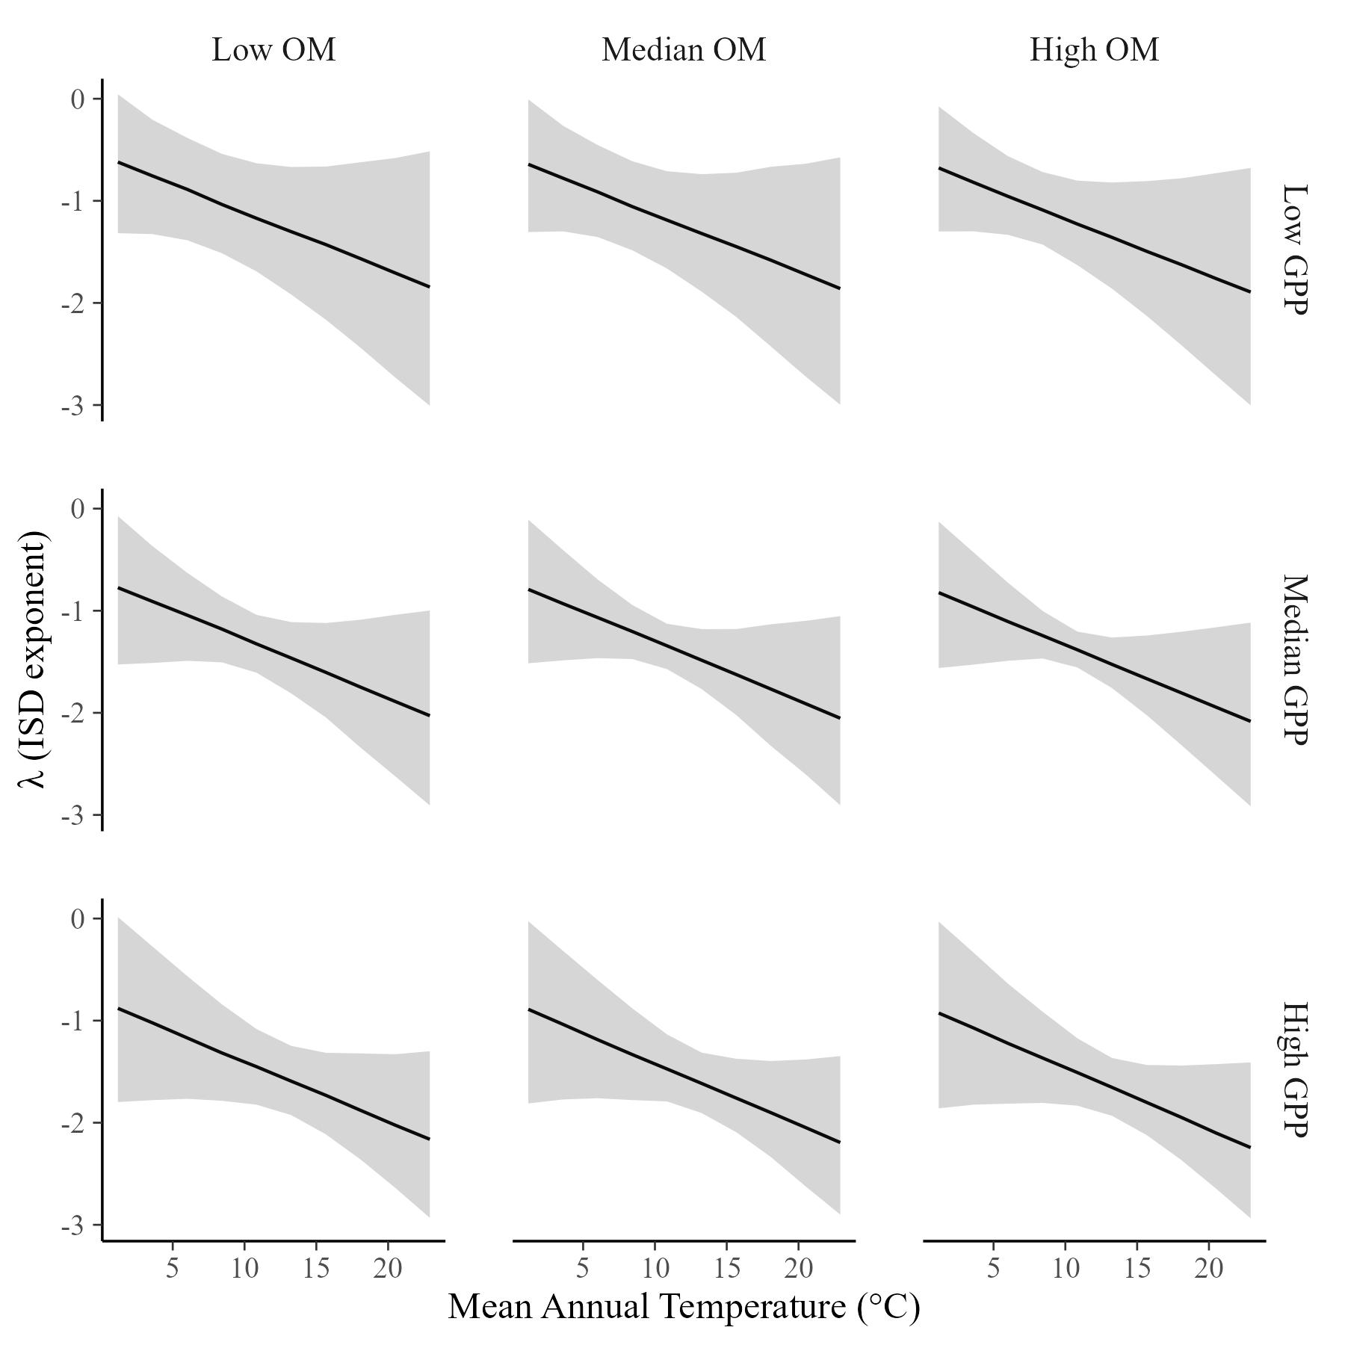
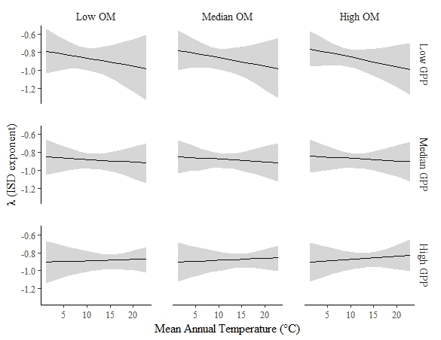
Fish weirdness: What value is xmin? If xmin is the smallest body size in the full dataset (~0.0035mg), then we get the plot on the left. If it is the smallest fish only (~60mg), then we get the plot on the right. What is the correct xmin to use here?

Slide 9
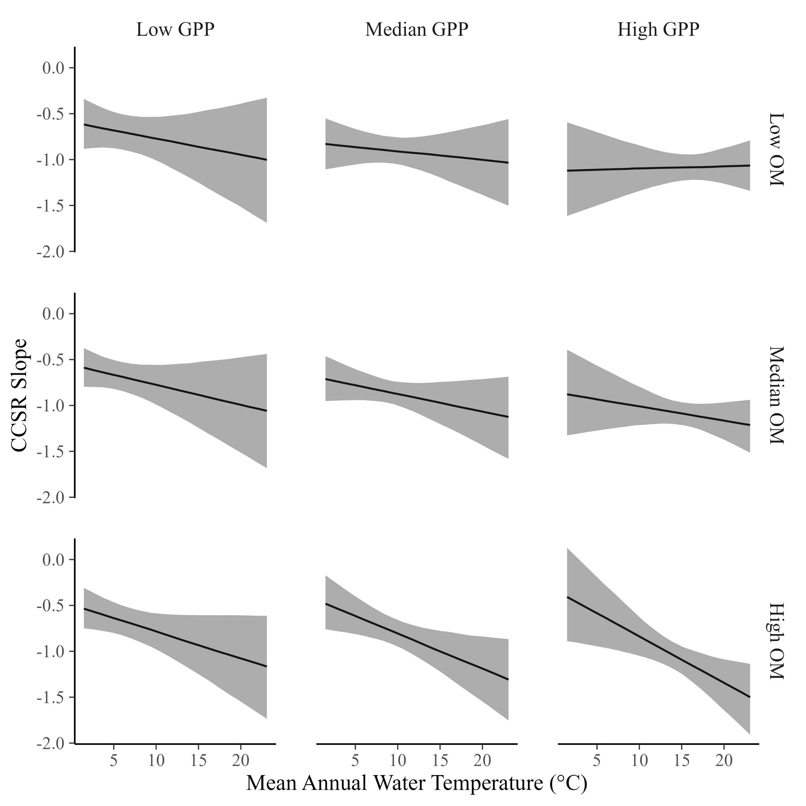
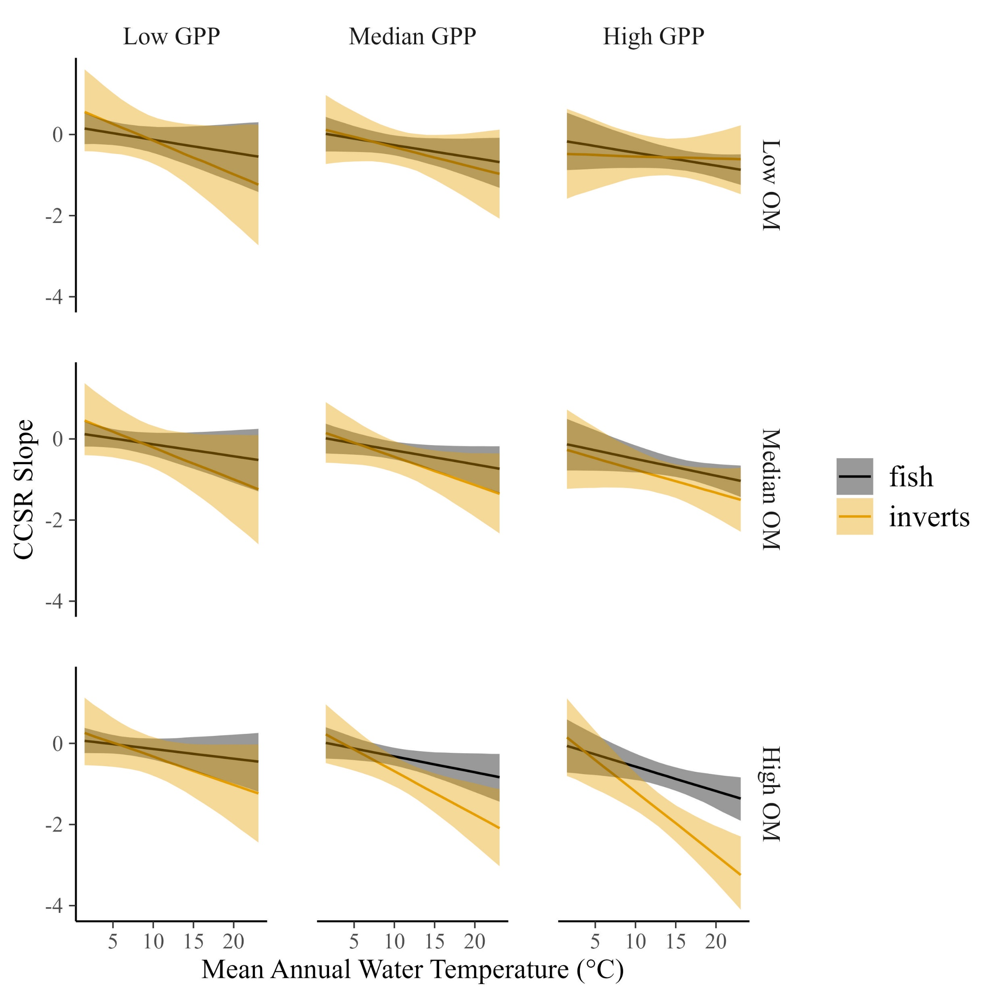
Perhaps for a different paper, but the cross-community size relationship also shows interesting patterns
The CCSR varies somewhat with temperature and resources, ranging from about -0.7 to -1…
…but that variation is minimal compared to the changes for fish or invertebrates separately.

Slide 10
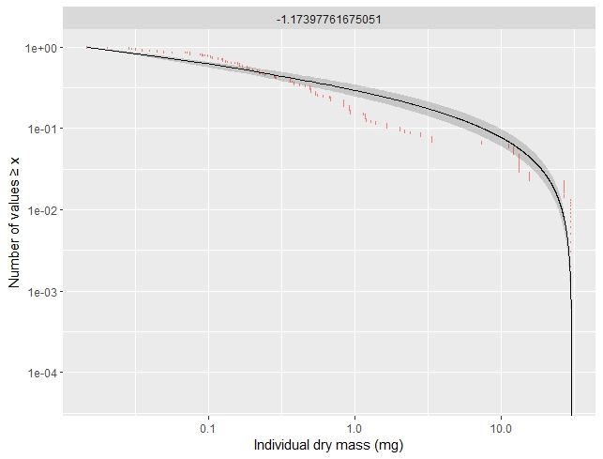
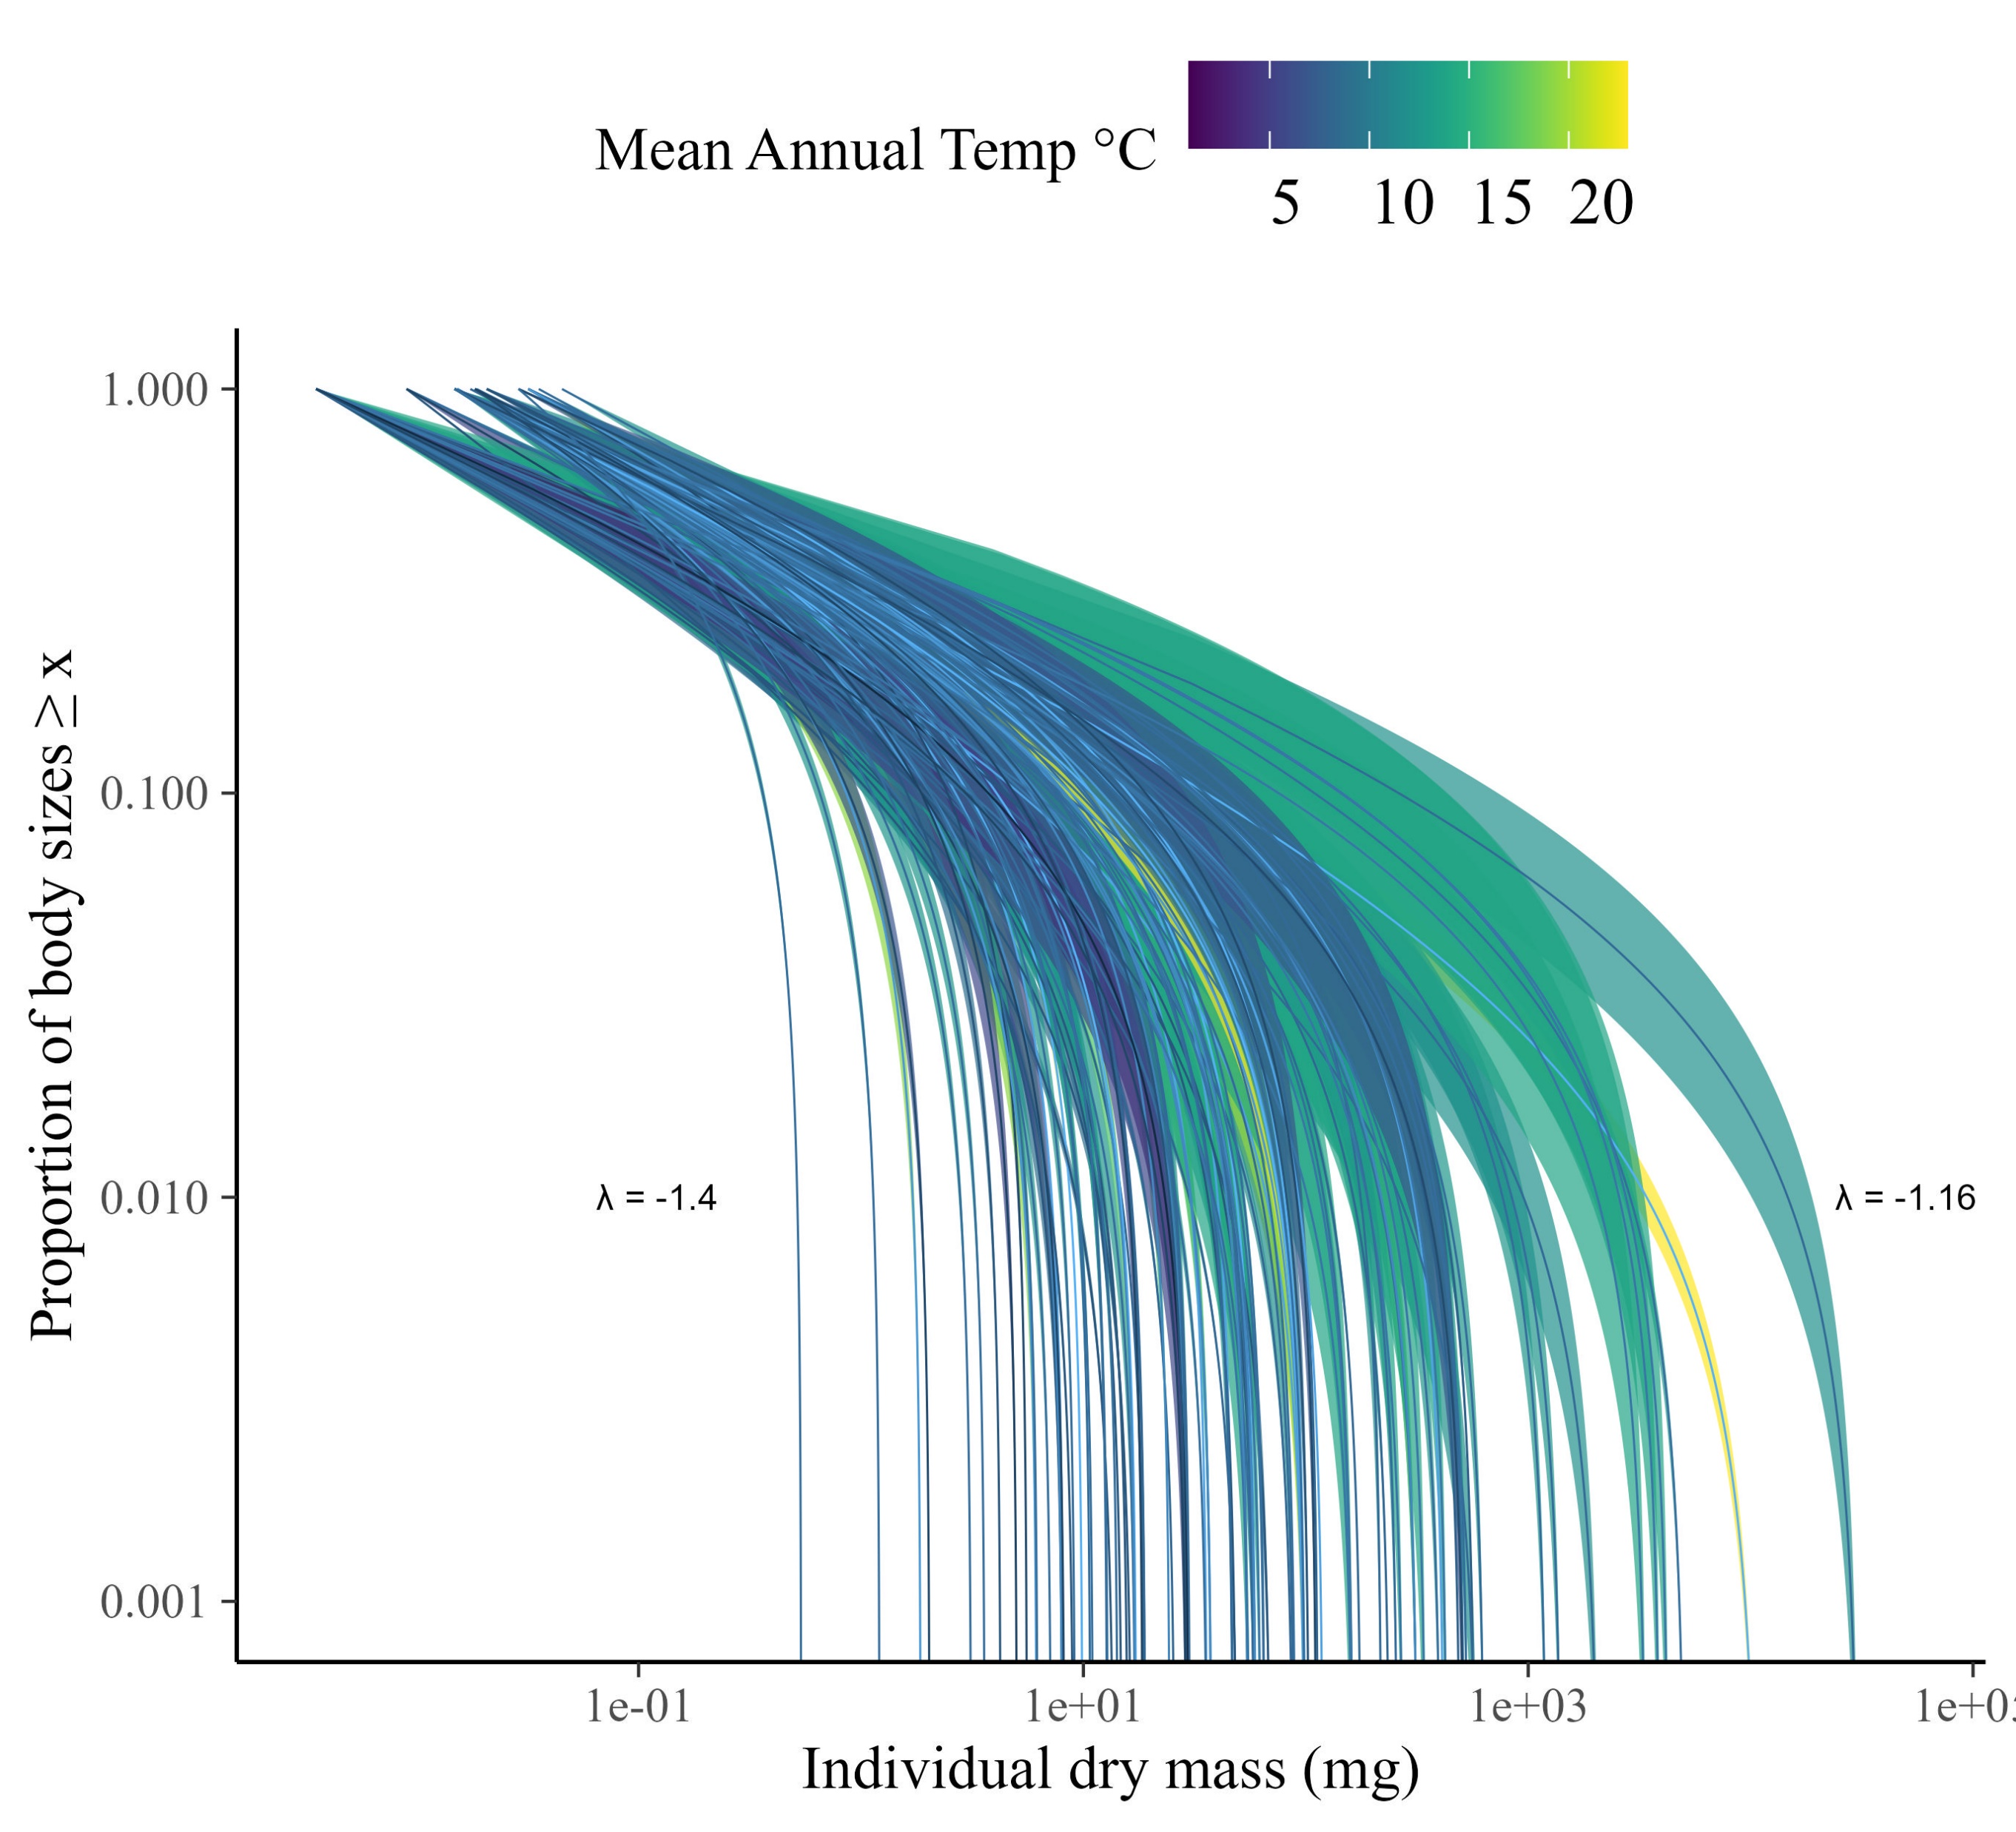
ISD’s vary among samples (posteriors shown).

Slide 11
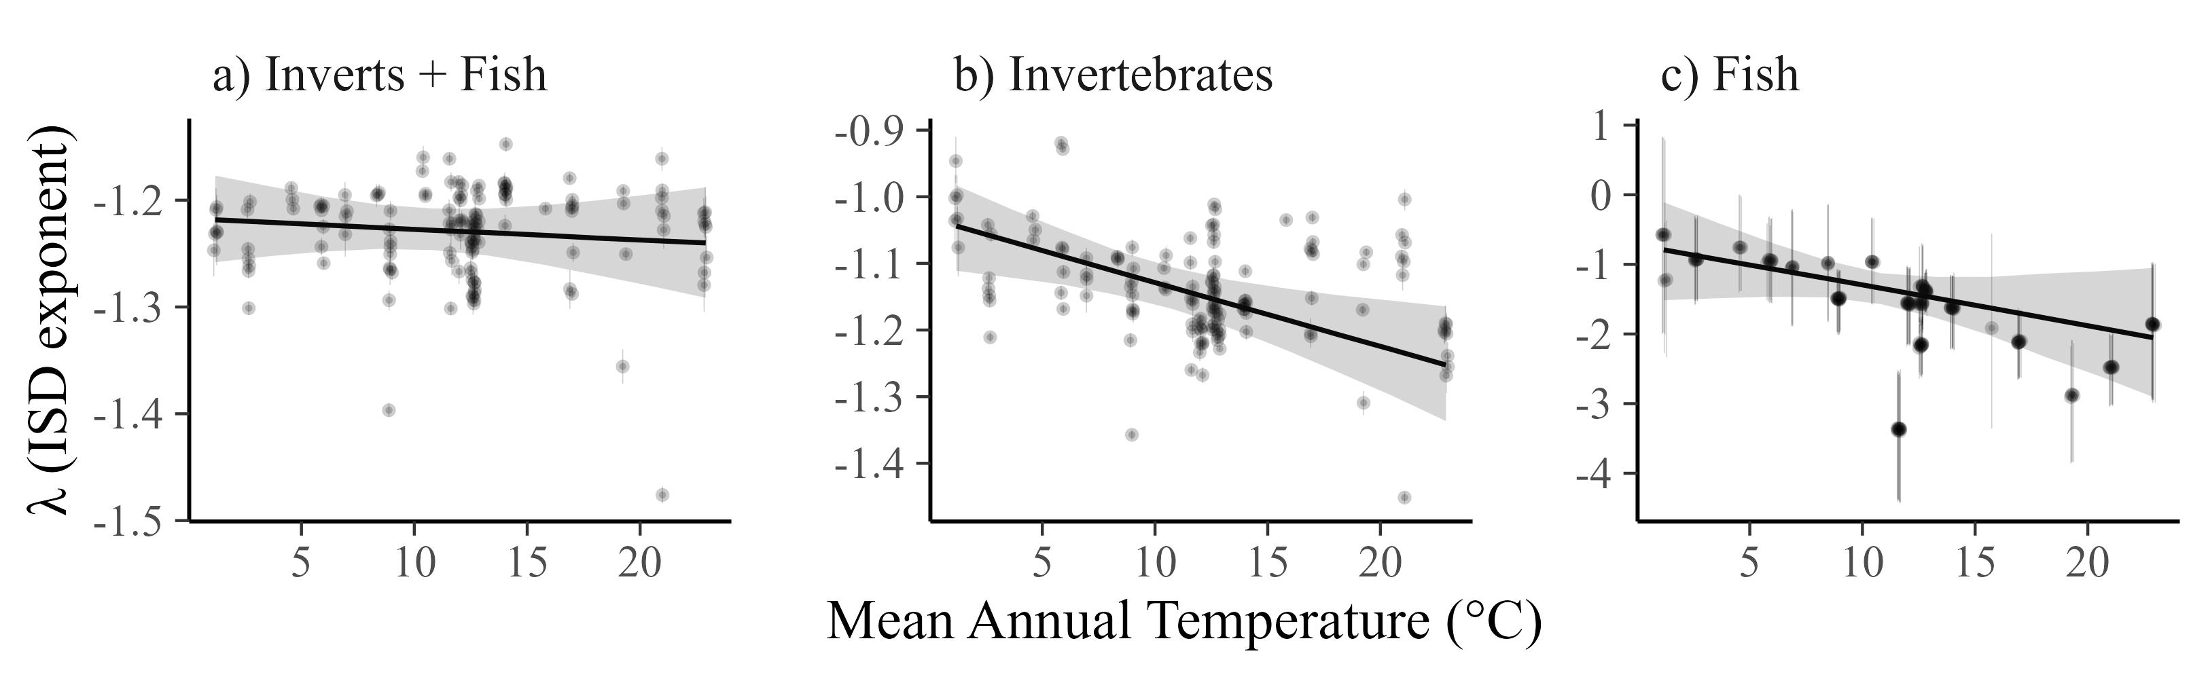
But ISD does not vary with temperature
*Note the change in y-axis scales across panels.

Slide 12
ISD consistency is independent of OM and GPP (i.e., no interactions)

Slide 13
However, for individual taxa (inverts and fish), the ISD declines with temperature, particularly for fish.
*Note the change in y-axis scales across panels.

Slide 14
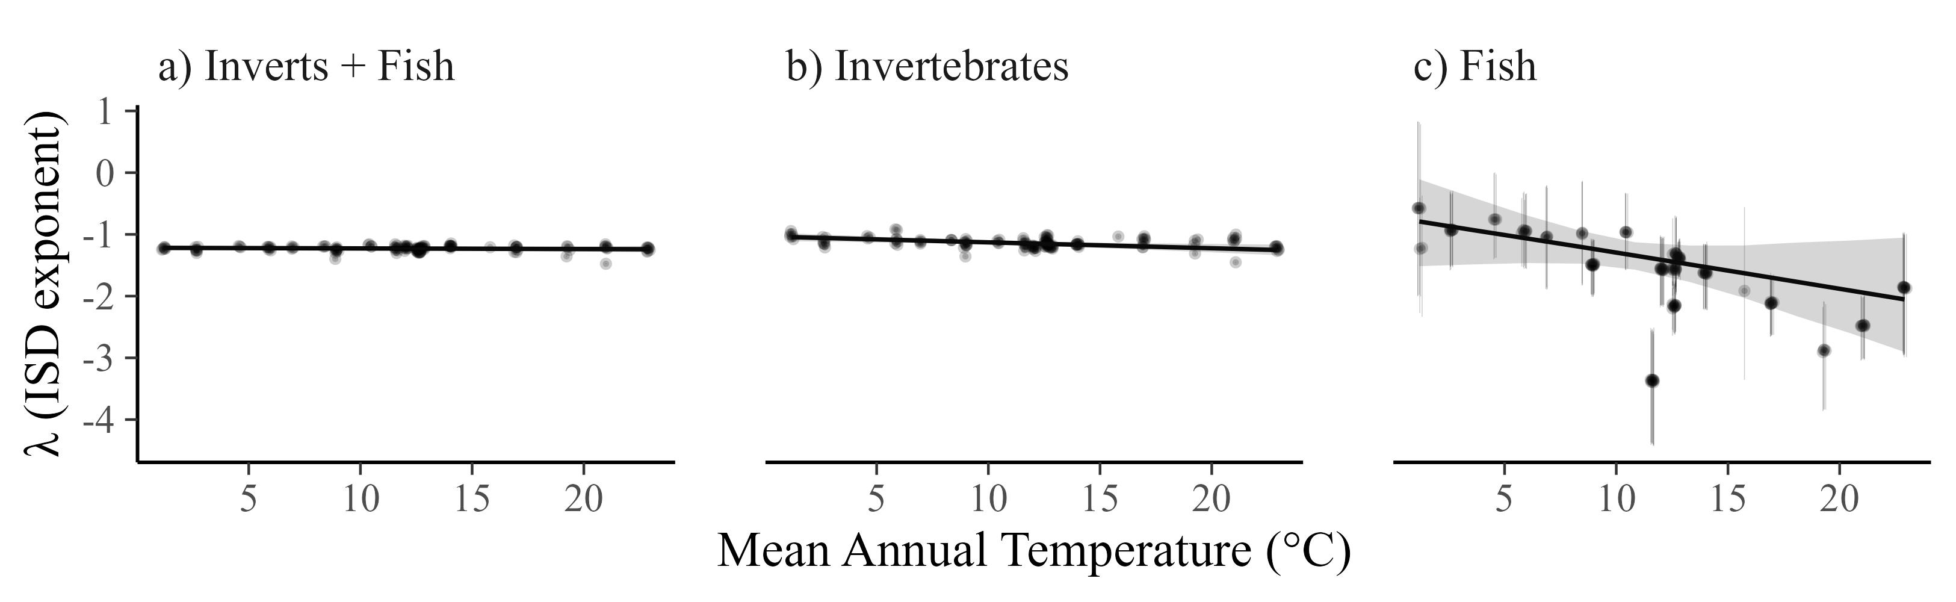
Same plot but with a common scale. Fish are odd.

Slide 15
For fish and inverts, the ISD relationship with temperature does not interact with resource supply

Slide 16
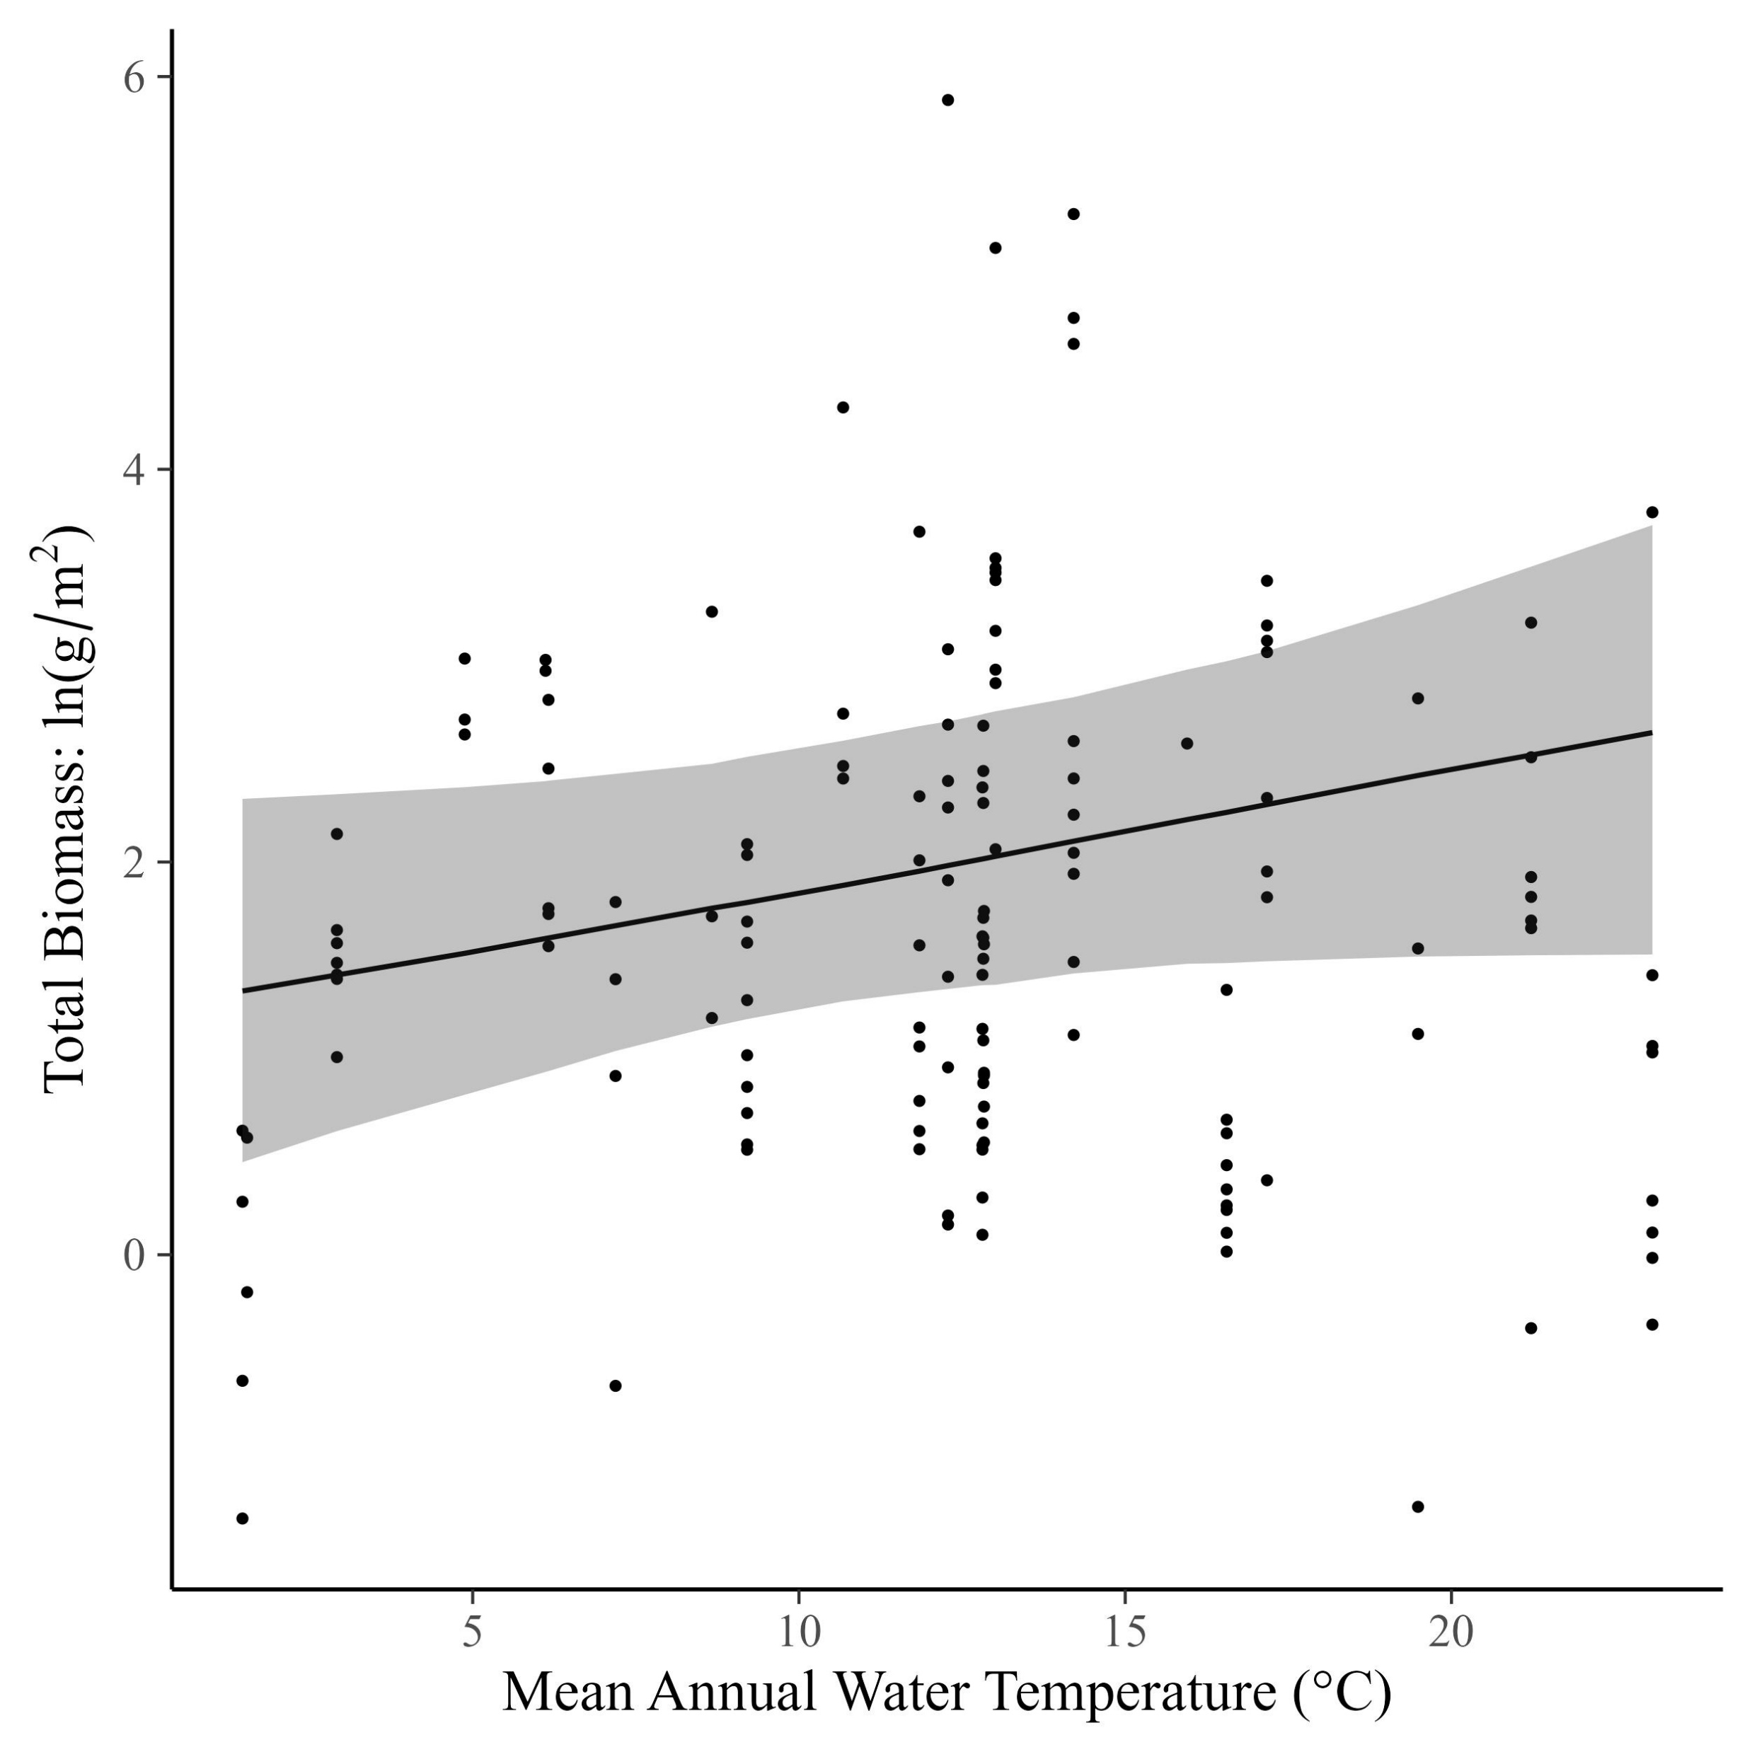
Total community mass weakly increases with temperature (0.04 [95% CI: -0.22, 0.3])

Slide 17
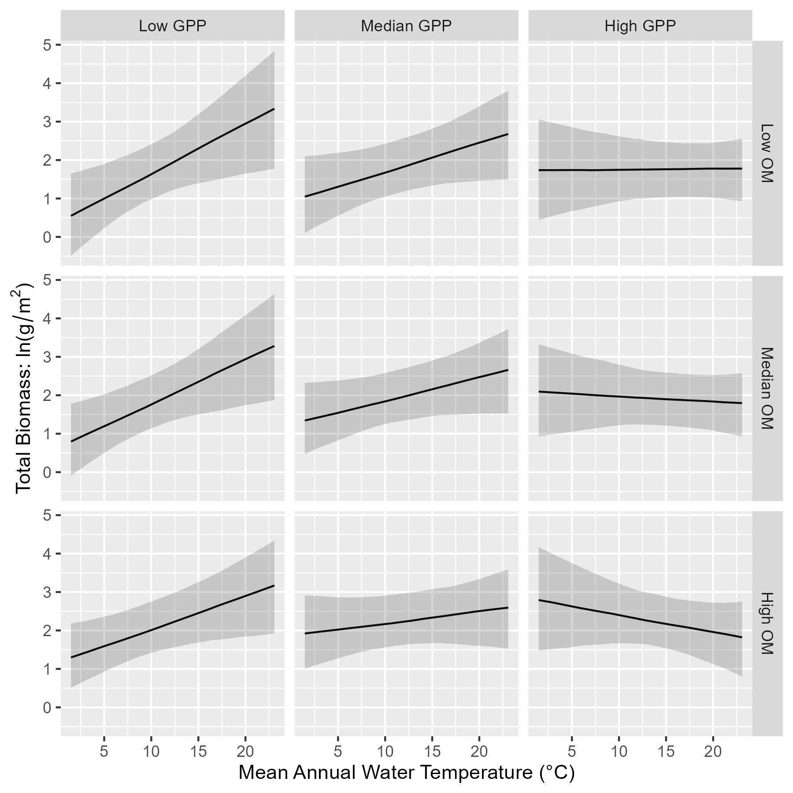
But…relationship of total biomass with temperature depends on resources. It is positive at low GPP and low OM, but becomes negative at high GPP and high OM.

Slide 18
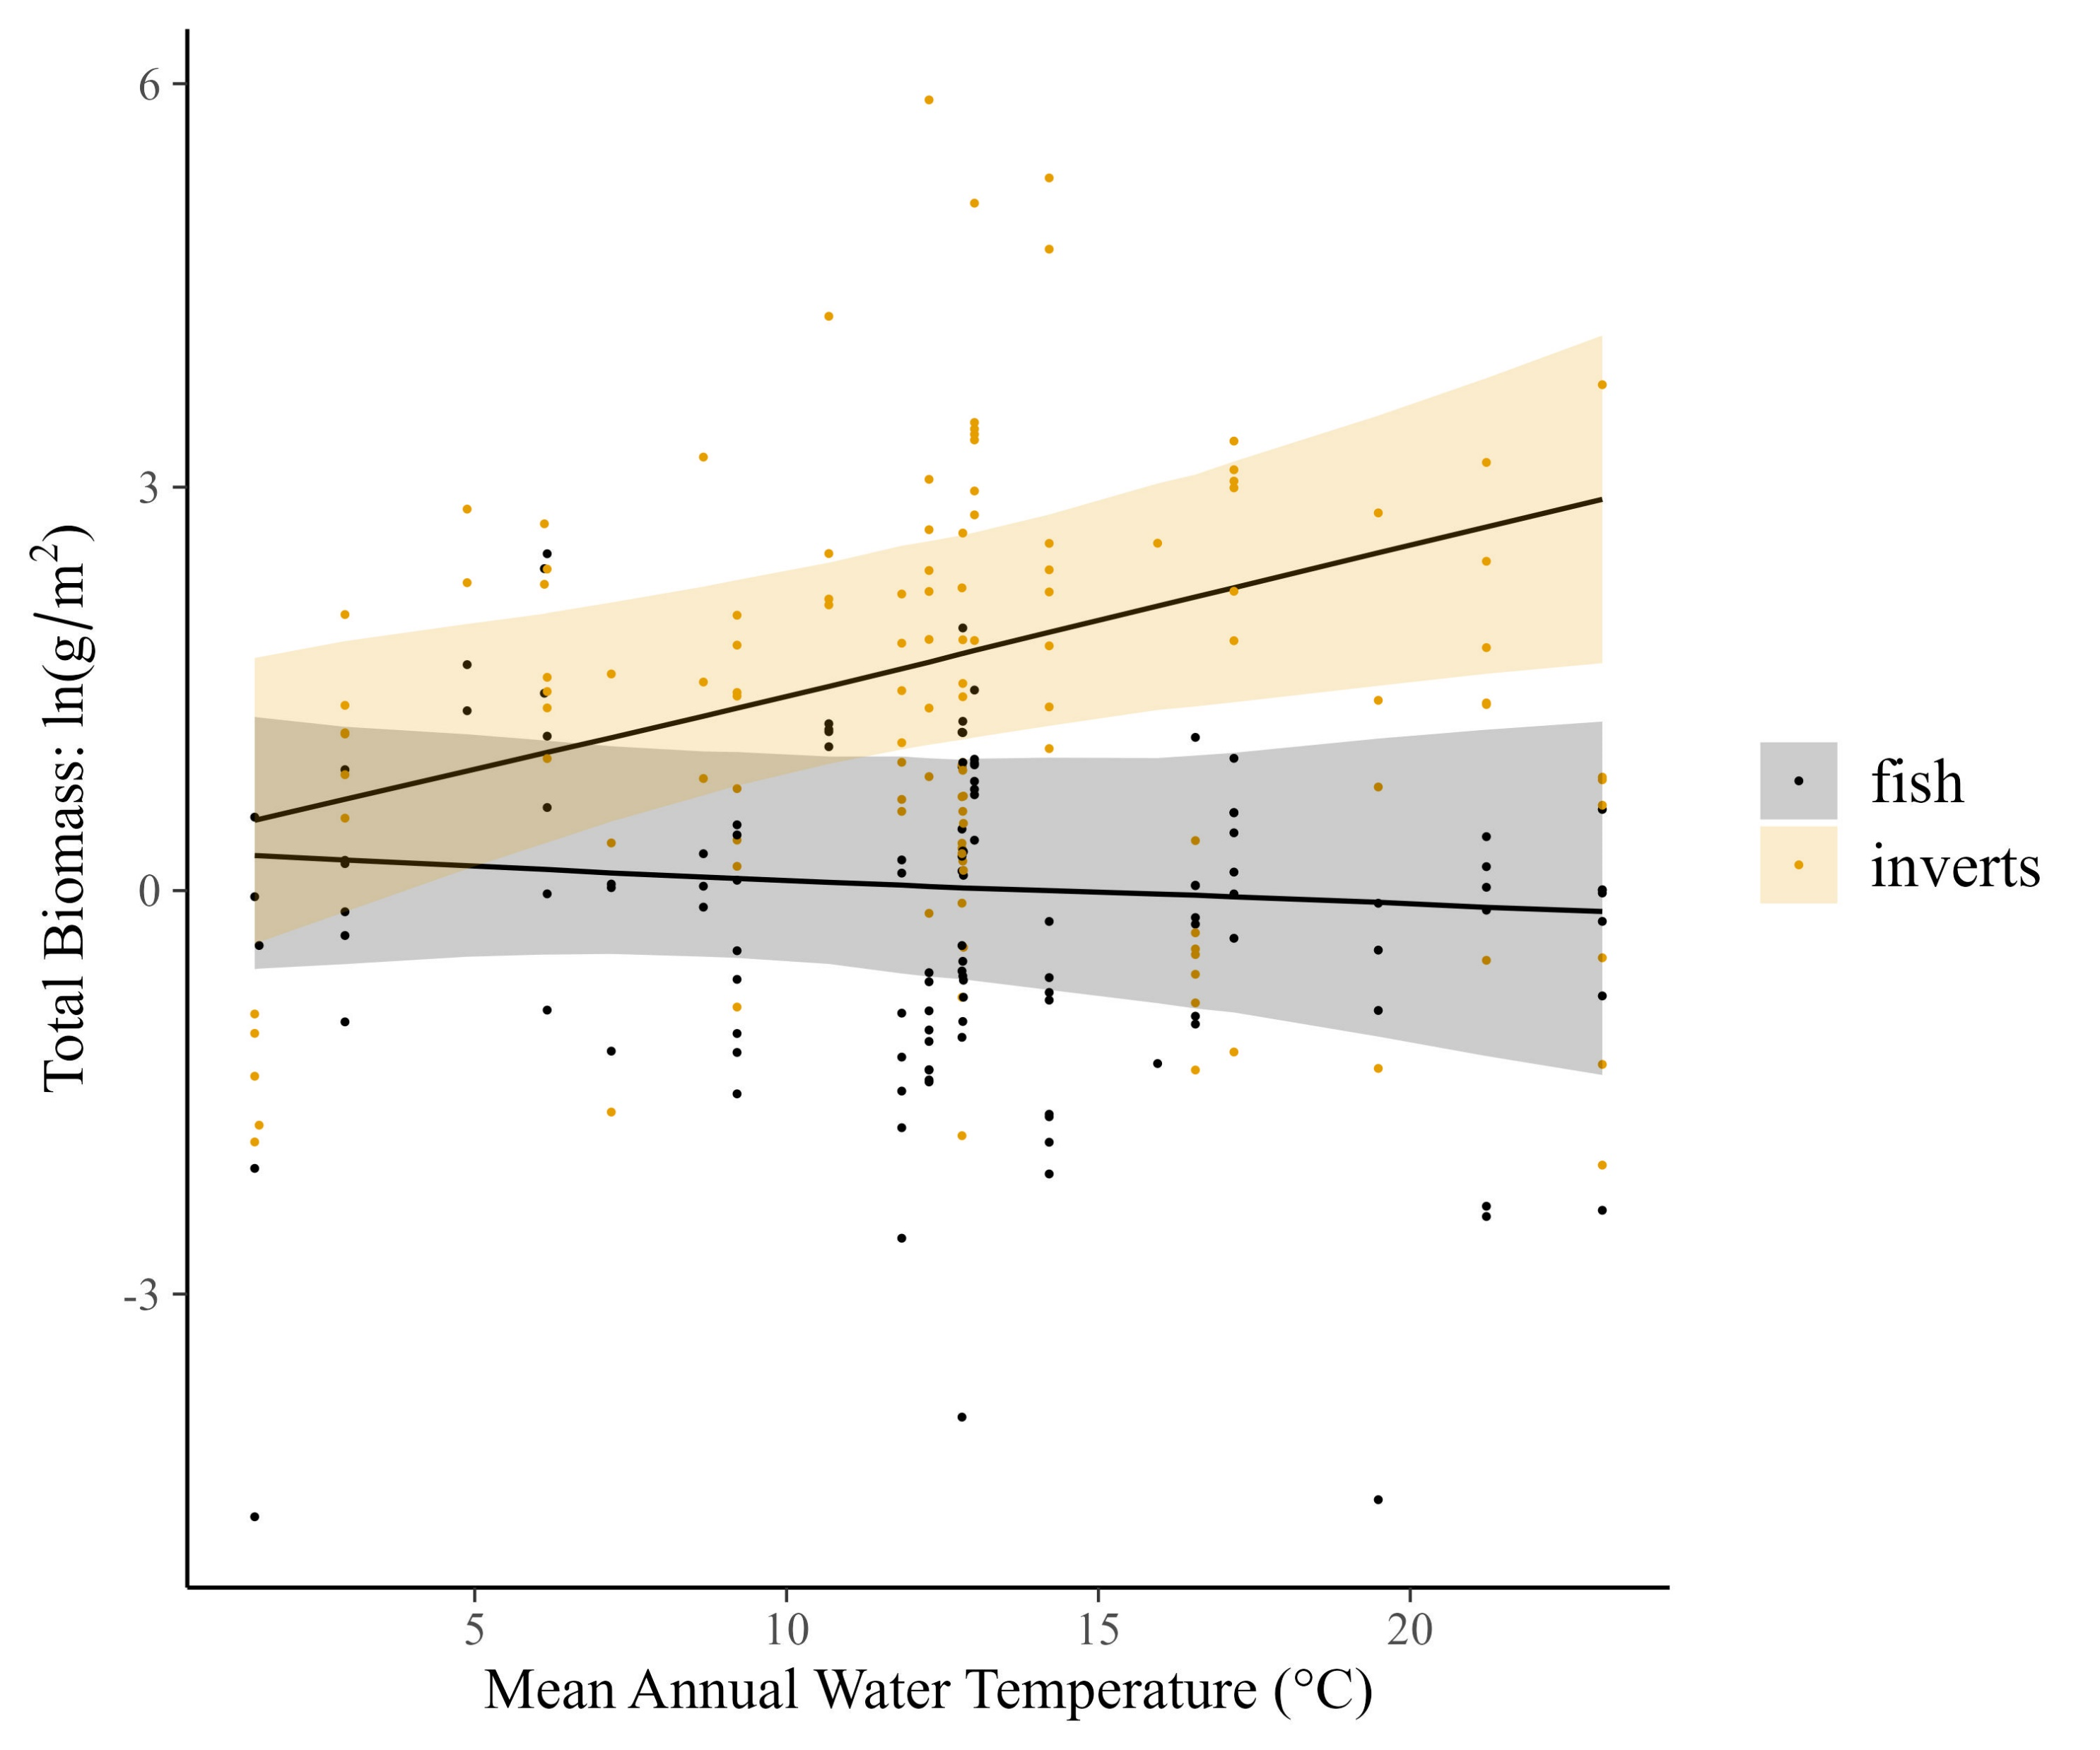
Temperature dependence of total biomass also differs for fish and inverts

Slide 19
Temperature dependence of total biomass also differs for fish and inverts…with interactions of resource supply

Slide 20
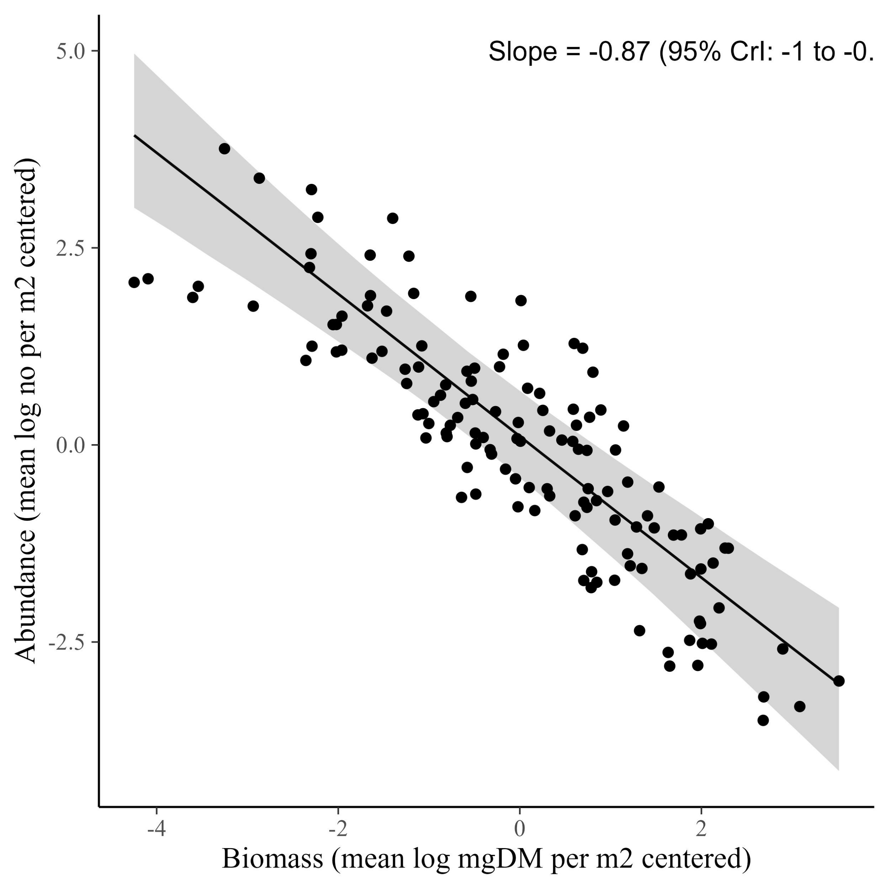
The CCSR is -0.87

Slide 21
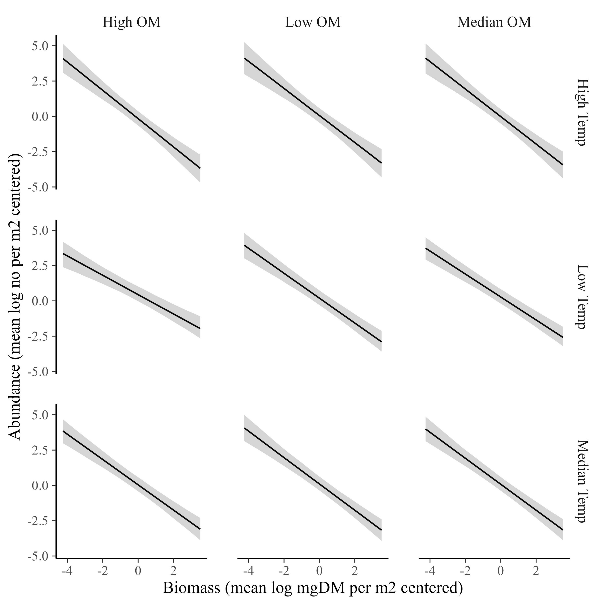
The CCSR for the whole community is invariant across temperature and resources (data shown with GPP at it’s median)

Slide 22
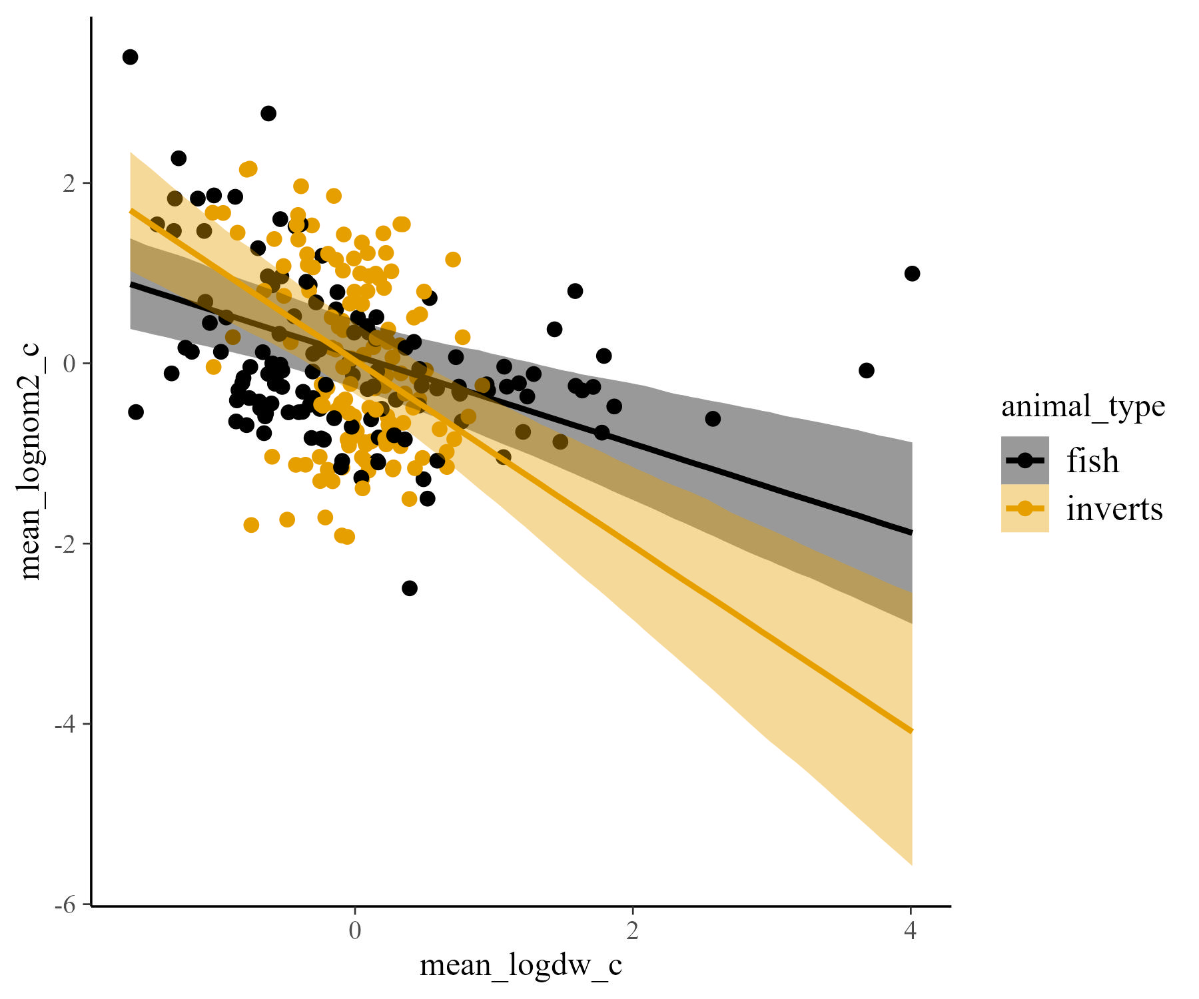
It varies by animal type, however (fish are -0.4, inverts are -0.9)

Slide 23
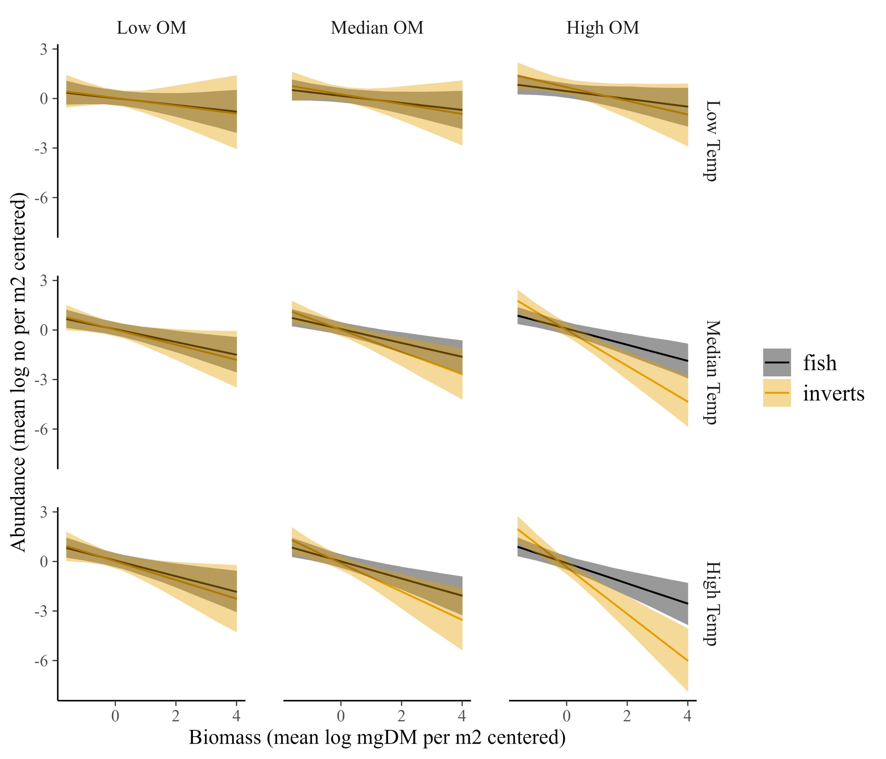
The CCSR becomes more negative at high temperature and high resource, especially for inverts (data shown with GPP at it’s median)

